Slide 1
CS 179: Lecture 15
Introduction to CuDNN (CUDA Deep Neural Nets)

Slide 2
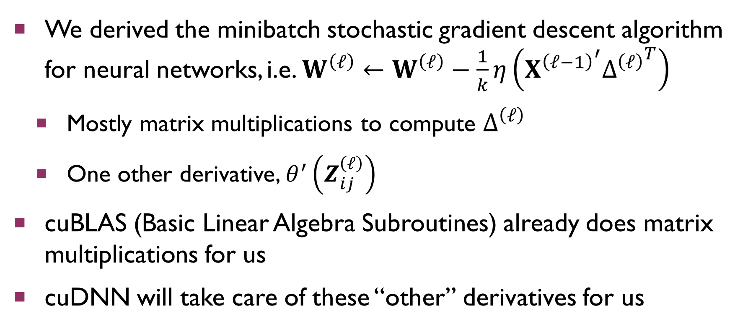
Last Time
We derived the minibatch stochastic gradient descent algorithm for neural networks, i.e. $W^{\left(ℓ\right)}←W^{\left(ℓ\right)}−\frac{1}{k}η\left({X^{\left(ℓ−1\right)}}^{′}{Δ^{\left(ℓ\right)}}^{T}\right)$
Mostly matrix multiplications to compute $Δ^{\left(ℓ\right)}$
One other derivative, $θ^{′}\left(Z_{ij}^{\left(ℓ\right)}\right)$
cuBLAS (Basic Linear Algebra Subroutines) already does matrix multiplications for us
cuDNN will take care of these “other” derivatives for us

Slide 3
Today
Using cuDNN to do deep neural networks

Slide 4
Setting up cuDNN
cudnnHandle_t
Like cuBLAS, you need to maintain cuDNN library context
Call cudnnCreate(cudnnHandle_t *handle) to initialize the context
Call cudnnDestroy(cudnnHandle_t handle) to clean up the context

Slide 5
Handling Errors
Almost every function we will talk about today returns a cudnnStatus_t (an enum saying whether a cuDNN call was successful or how it failed)
Like standard CUDA, we will provide you with a checkCUDNN(cudnnStatus_t status) wrapper function that parses any error statuses for you
Make sure you wrap every function call with this function so you know where and how your code breaks!

Slide 6
Reminders About CUDA
Pattern of allocate → initialize → free (reiterate here for students who may not be as comfortable with C++)

Slide 7
Data Representation
cudnnTensor_t
For the purposes of cuDNN (and much of machine learning), a tensor is just a multidimensional array
A wrapper around a “flattened” 3-8 dimensional array
Used to represent minibatches of data
For now, we will be using “flattened” 4D arrays to represent each minibatch X

Slide 8
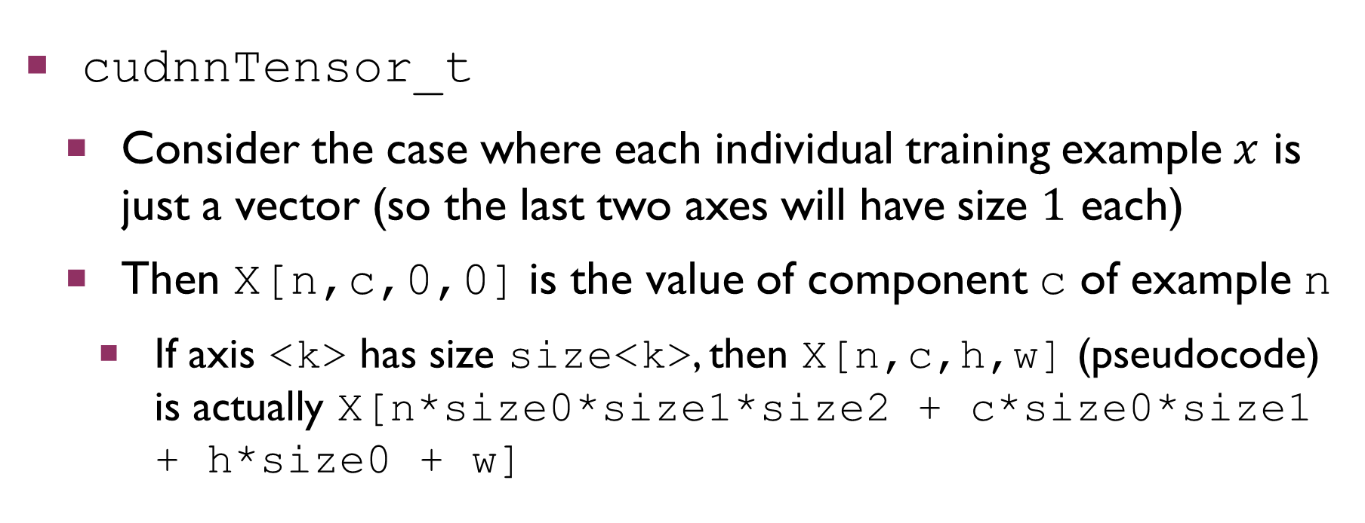
Data Representation
cudnnTensor_t
Consider the case where each individual training example $x$ is just a vector (so the last two axes will have size $1$ each)
Then X[n,c,0,0] is the value of component c of example n
If axis <k> has size size<k>, then X[n,c,h,w] (pseudocode) is actually X[n*size0*size1*size2 + c*size0*size1 + h*size0 + w]

Slide 9
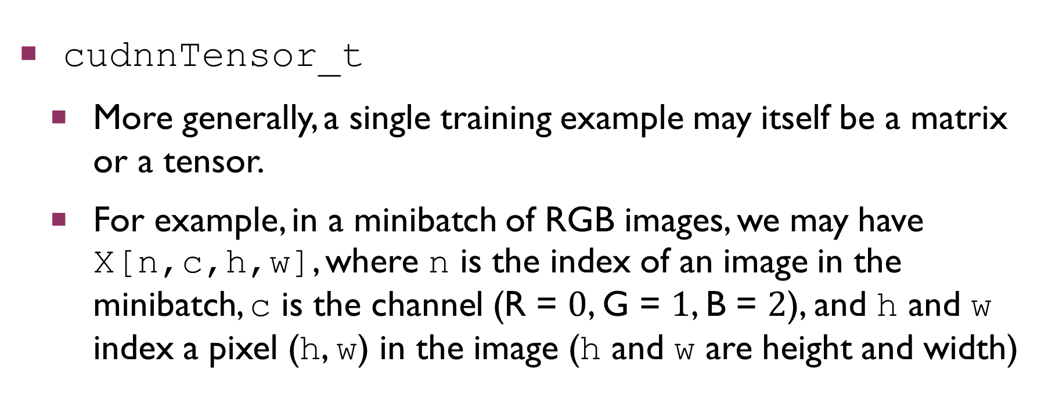
Data Representation
cudnnTensor_t
More generally, a single training example may itself be a matrix or a tensor.
For example, in a minibatch of RGB images, we may have X[n,c,h,w], where n is the index of an image in the minibatch, c is the channel (R = $0$, G = $1$, B = $2$), and h and w index a pixel (h, w) in the image (h and w are height and width)

Slide 10
Data Representation
cudnnTensorDescriptor_t
Allocate by calling cudnnCreateTensorDescriptor( cudnnTensorDescriptor_t *desc)
The ordering of array axes is defined by an enum called a cudnnTensorFormat_t (since we are indexing as X[n,c,h,w], we will use CUDNN_TENSOR_NCHW)
A cudnnDataType_t specifies the data type of the tensor (we will use CUDNN_DATA_FLOAT)

Slide 11
Data Representation
cudnnTensorDescriptor_t
Initialize by calling cudnnSetTensor4dDescriptor( cudnnTensorDescriptor_t desc, cudnnTensorFormat_t format, cudnnDataType_t dataType, int n, int c, int h, int w)
Free by calling cudnnDestroyTensorDescriptor( cudnnTensorDescriptor_t desc)

Slide 12
Data Representation
cudnnTensorDescriptor_t
Get the contents by calling cudnnGetTensor4dDescriptor( cudnnTensorDescriptor_t desc, cudnnDataType_t dataType, int *n, int *c, int *h, int *w, int *nStr, int *cStr, int *hStr, int *wStr)
Standard trick of returning by setting output parameters
Don’t worry about the strides nStr, cStr, hStr, wStr

Slide 13
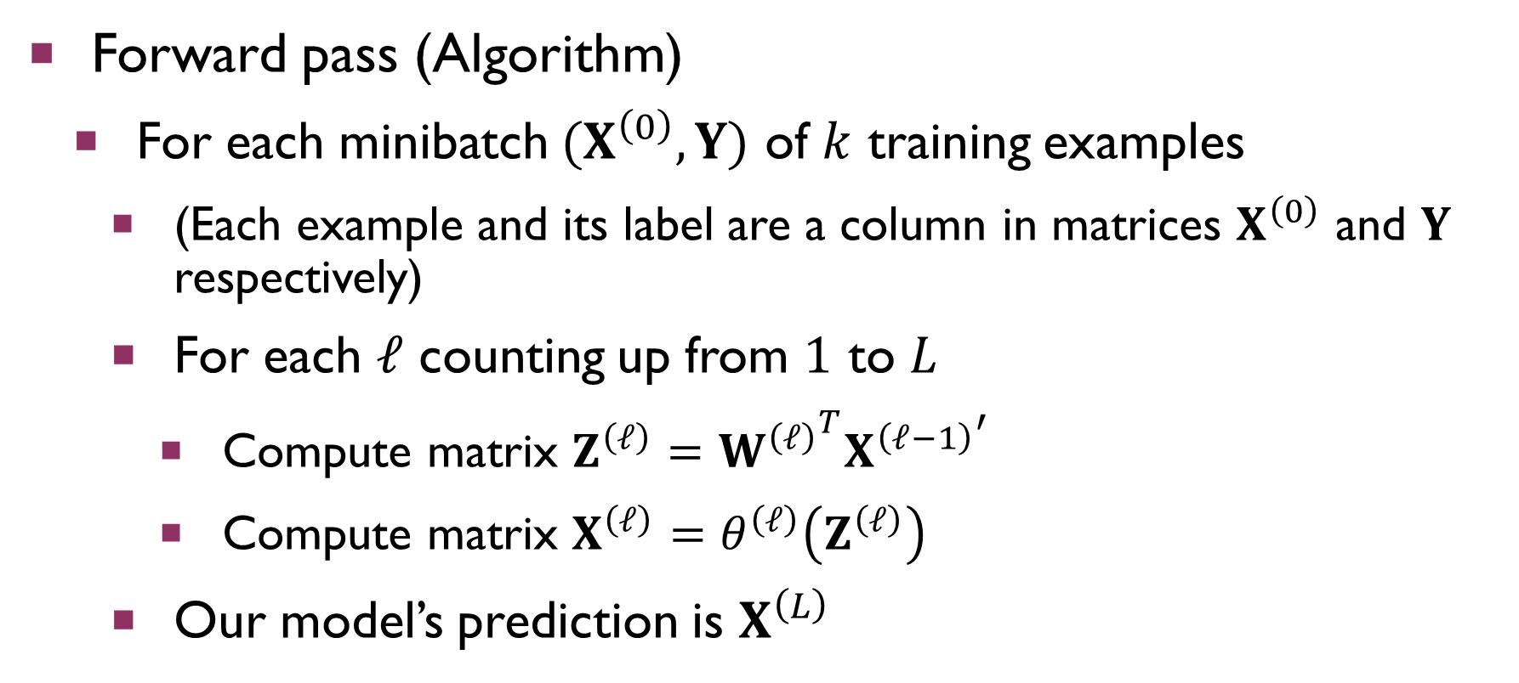
Relation to Assignment 5
Forward pass (Algorithm)
For each minibatch $(X^{\left(0\right)},Y)$ of $k$ training examples
(Each example and its label are a column in matrices $X^{\left(0\right)}$ and $Y$ respectively)
For each $ℓ$ counting up from $1$ to $L$
Compute matrix $Z^{\left(ℓ\right)}={W^{\left(ℓ\right)}}^{T}{X^{\left(ℓ−1\right)}}^{′}$
Compute matrix $X^{\left(ℓ\right)}=θ^{\left(ℓ\right)}\left(Z^{\left(ℓ\right)}\right)$
Our model’s prediction is $X^{\left(L\right)}$

Slide 14
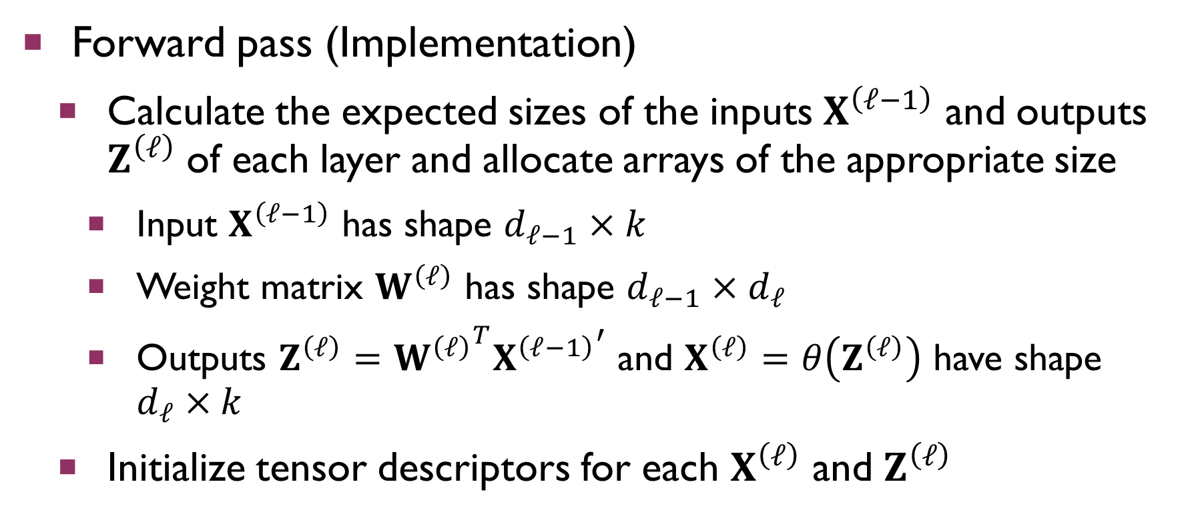
Relation to Assignment 5
Forward pass (Implementation)
Calculate the expected sizes of the inputs $X^{\left(ℓ−1\right)}$ and outputs $Z^{\left(ℓ\right)}$ of each layer and allocate arrays of the appropriate size
Input $X^{\left(ℓ−1\right)}$ has shape $d_{ℓ−1}×k$
Weight matrix $W^{\left(ℓ\right)}$ has shape $d_{ℓ−1}×d_{ℓ}$
Outputs $Z^{\left(ℓ\right)}={W^{\left(ℓ\right)}}^{T}{X^{\left(ℓ−1\right)}}^{′}$ and $X^{\left(ℓ\right)}=θ\left(Z^{\left(ℓ\right)}\right)$ have shape $d_{ℓ}×k$
Initialize tensor descriptors for each $X^{\left(ℓ\right)}$ and $Z^{\left(ℓ\right)}$

Slide 15
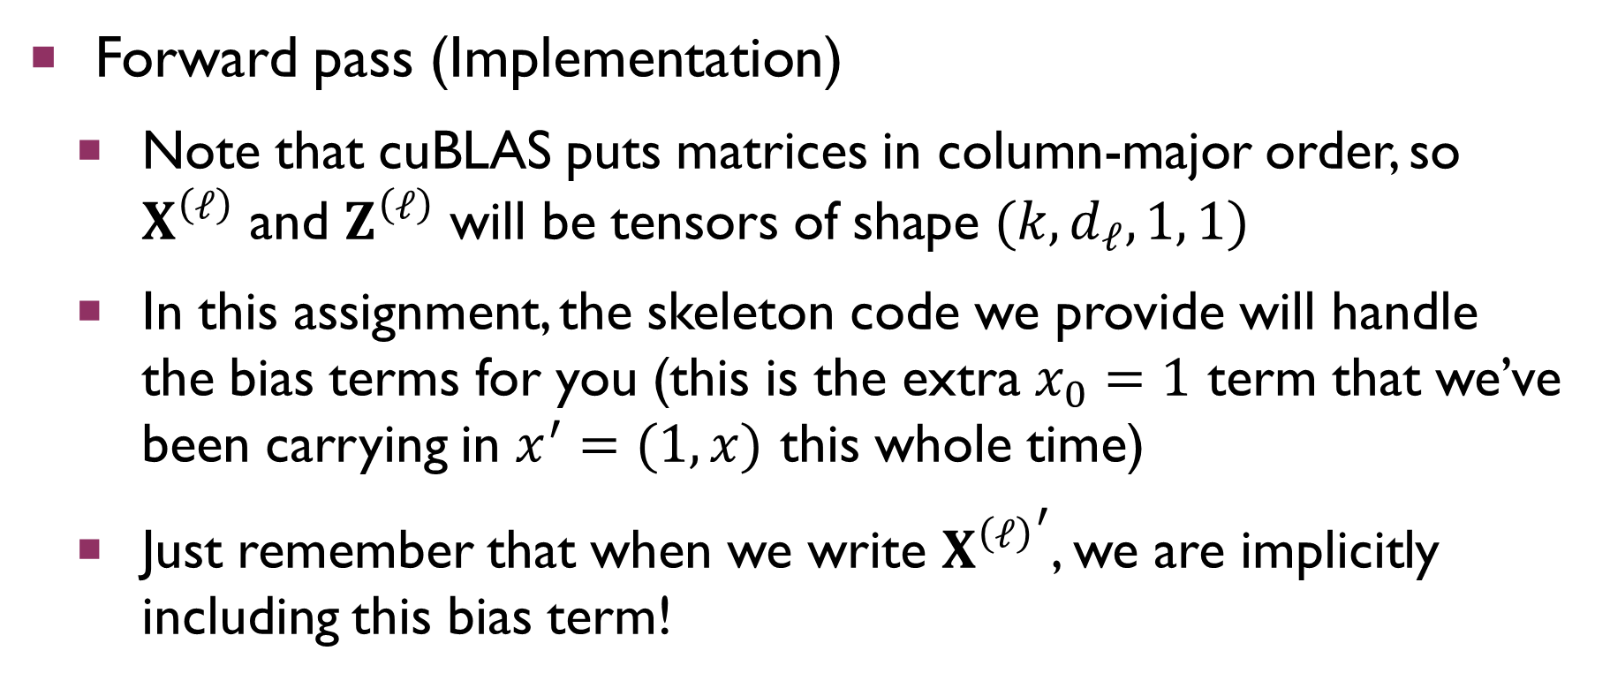
Relation to Assignment 5
Forward pass (Implementation)
Note that cuBLAS puts matrices in column-major order, so $X^{\left(ℓ\right)}$ and $Z^{\left(ℓ\right)}$ will be tensors of shape $(k, d_{ℓ},1, 1)$
In this assignment, the skeleton code we provide will handle the bias terms for you (this is the extra $x_{0}=1$ term that we’ve been carrying in $x^{′}=(1,x)$ this whole time)
Just remember that when we write ${X^{\left(ℓ\right)}}^{′}$, we are implicitly including this bias term!

Slide 16
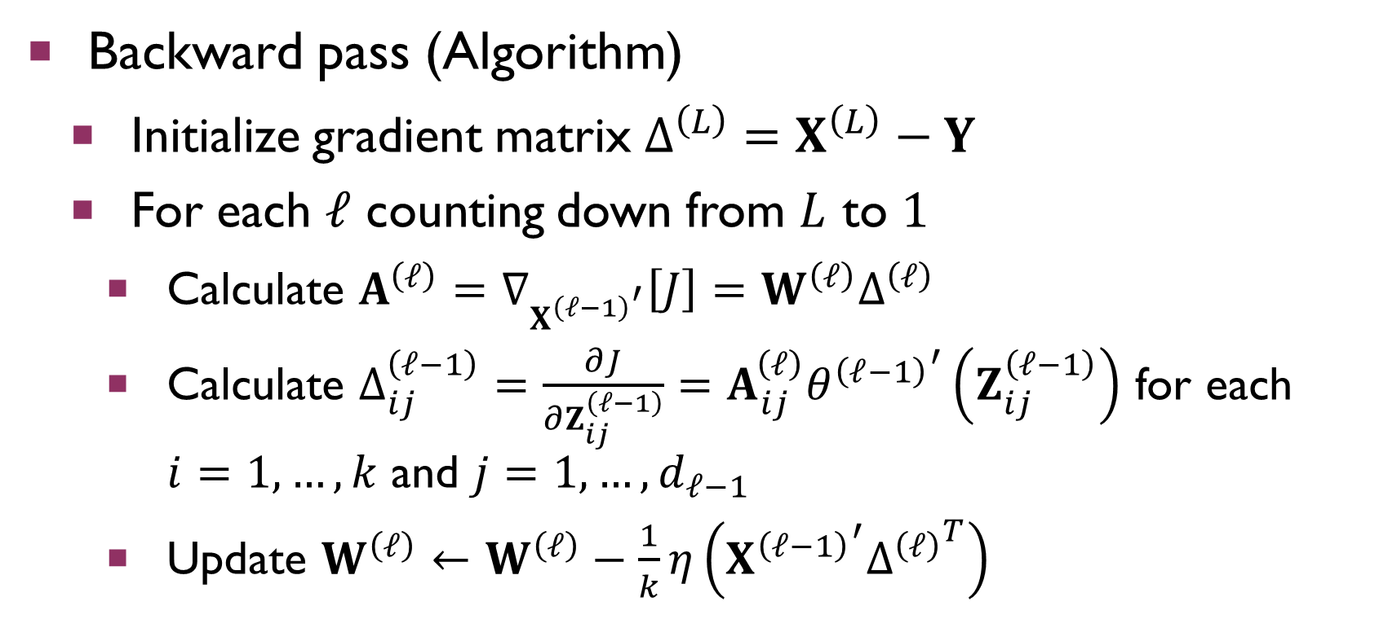
Relation to Assignment 5
Backward pass (Algorithm)
Initialize gradient matrix $Δ^{\left(L\right)}=X^{\left(L\right)}−Y$
For each $ℓ$ counting down from $L$ to $1$
Calculate $A^{\left(ℓ\right)}=∇_{{X^{\left(ℓ−1\right)}}^{′}}\left[J\right]=W^{\left(ℓ\right)}Δ^{\left(ℓ\right)}$
Calculate $Δ_{ij}^{\left(ℓ−1\right)}=\frac{∂J}{∂Z_{ij}^{\left(ℓ−1\right)}}=A_{ij}^{\left(ℓ\right)}{θ^{\left(ℓ−1\right)}}^{′}\left(Z_{ij}^{\left(ℓ−1\right)}\right)$ for each $i=1,…,k$ and $j=1,…,d_{ℓ−1}$
Update $W^{\left(ℓ\right)}←W^{\left(ℓ\right)}−\frac{1}{k}η\left({X^{\left(ℓ−1\right)}}^{′}{Δ^{\left(ℓ\right)}}^{T}\right)$

Slide 17
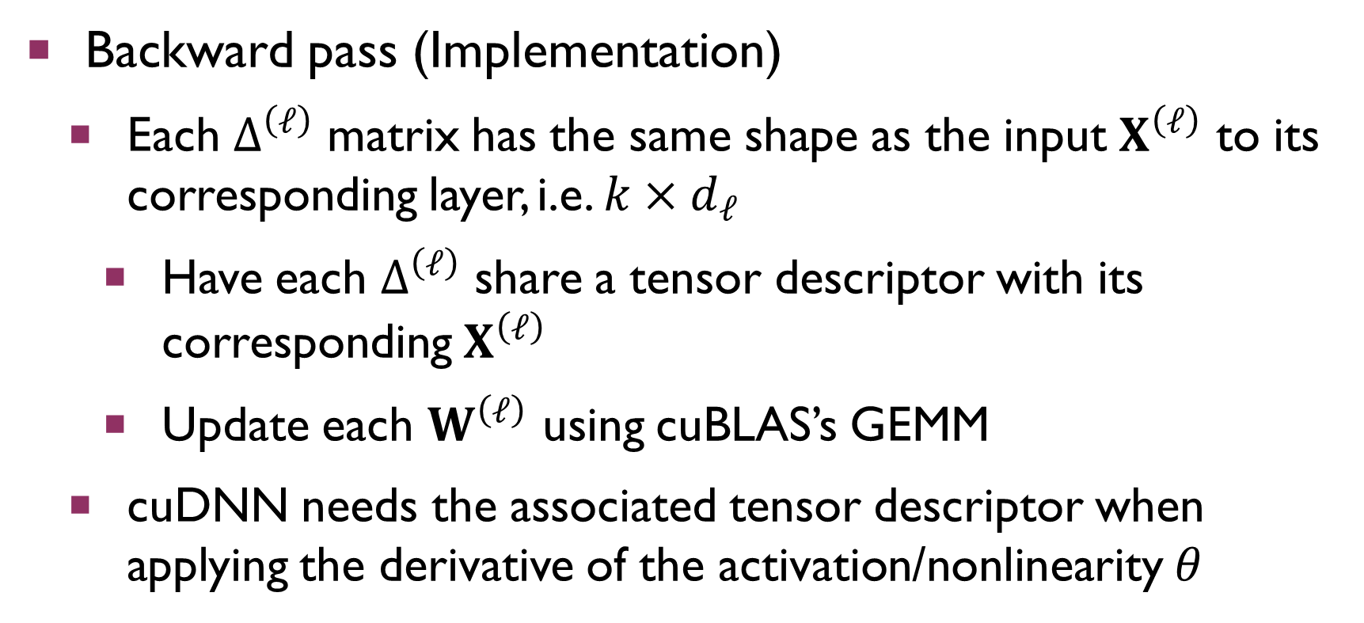
Relation to Assignment 5
Backward pass (Implementation)
Each $Δ^{\left(ℓ\right)}$ matrix has the same shape as the input $X^{\left(ℓ\right)}$ to its corresponding layer, i.e. $k×d_{ℓ}$
Have each $Δ^{\left(ℓ\right)}$ share a tensor descriptor with its corresponding $X^{\left(ℓ\right)}$
Update each $W^{\left(ℓ\right)}$ using cuBLAS’s GEMM
cuDNN needs the associated tensor descriptor when applying the derivative of the activation/nonlinearity $θ$

Slide 18
Activation Functions
cudnnActivationDescriptor_t
Allocate with cudnnCreateActivationDescriptor( cudnnActivationDescriptor_t *desc)
Destroy with cudnnDestroyActivationDescriptor( cudnnActivationDescriptor_t desc)

Slide 19
Activation Functions
cudnnActivationMode_t
An enum that specifies the type of activation we should apply after any given layer
Specify as CUDNN_ACTIVATION_<type>
<type> can be SIGMOID, RELU, TANH, CLIPPED_RELU, or ELU (the last 2 are fancier activations that address some of the issues with ReLU); use RELU for this assignment

Slide 20
Activation Functions
Graphs of activations as a reminder

Slide 21
Activation Functions
cudnnNanPropagation_t
An enum that specifies whether to propagate NAN’s
Use CUDNN_PROPAGATE_NAN for this assignment

Slide 22
Activation Functions
cudnnActivationDescriptor_t
Set with cudnnSetActivationDescriptor( cudnnActivationDescriptor_t desc, cudnnActivationMode_t mode, cudnnNanPropagation_t reluNanOpt, double coef)
coef is relevant only for clipped ReLU and ELU activations, so just use 0.0 for this assignment

Slide 23
Activation Functions
cudnnActivationDescriptor_t
Get contents with cudnnGetActivationDescriptor( cudnnActivationDescriptor_t desc, cudnnActivationMode_t *mode, cudnnNanPropagation_t *reluNanOpt, double *coef)
coef is relevant only for clipped ReLU and ELU activations, so just give it a reference to a double for throwaway values

Slide 24
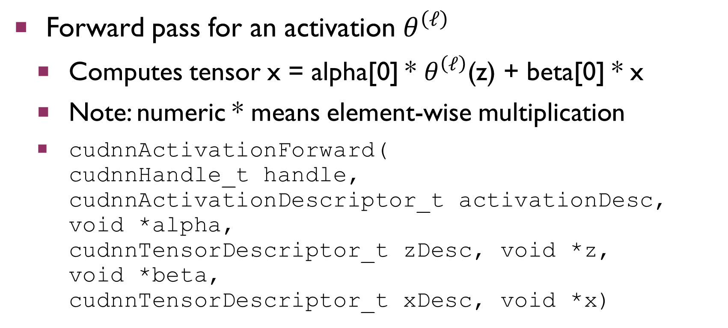
Activation Functions
Forward pass for an activation $θ^{\left(ℓ\right)}$
Computes tensor x = alpha[0] * $θ^{\left(ℓ\right)}$(z) + beta[0] * x
Note: numeric * means element-wise multiplication
cudnnActivationForward( cudnnHandle_t handle, cudnnActivationDescriptor_t activationDesc, void *alpha, cudnnTensorDescriptor_t zDesc, void *z, void *beta, cudnnTensorDescriptor_t xDesc, void *x)

Slide 25
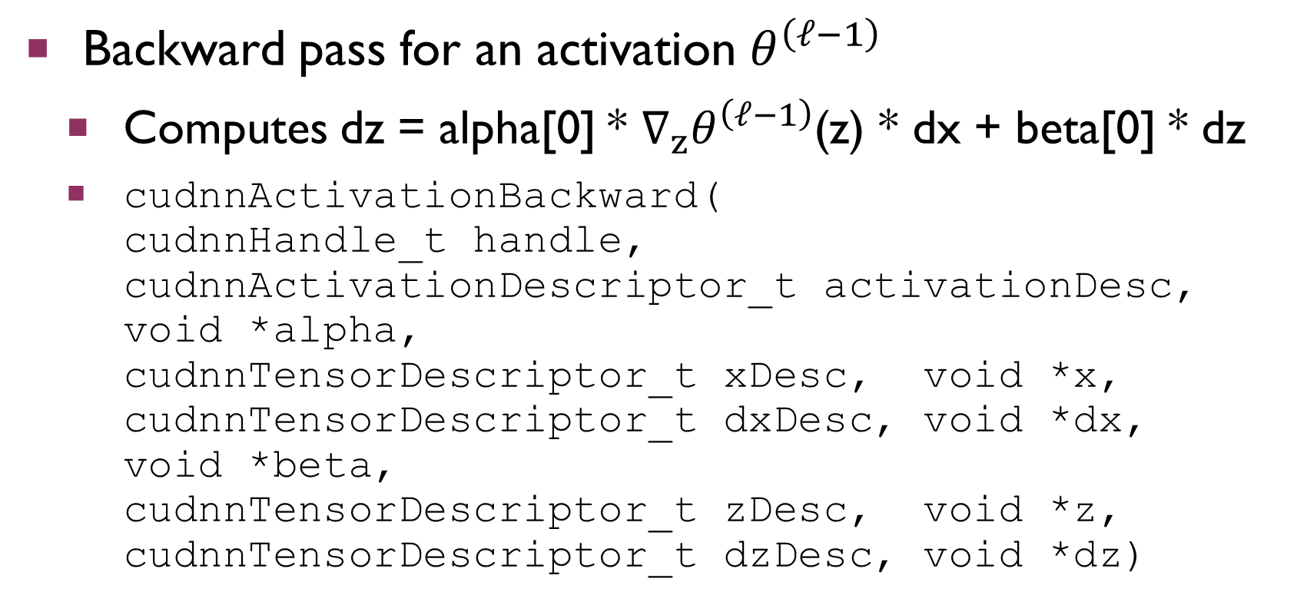
Activation Functions
Backward pass for an activation $θ^{\left(ℓ−1\right)}$
Computes dz = alpha[0] * $∇_{z}θ^{\left(ℓ−1\right)}$(z) * dx + beta[0] * dz
cudnnActivationBackward( cudnnHandle_t handle, cudnnActivationDescriptor_t activationDesc, void *alpha, cudnnTensorDescriptor_t xDesc, void *x, cudnnTensorDescriptor_t dxDesc, void *dx, void *beta, cudnnTensorDescriptor_t zDesc, void *z, cudnnTensorDescriptor_t dzDesc, void *dz)

Slide 26
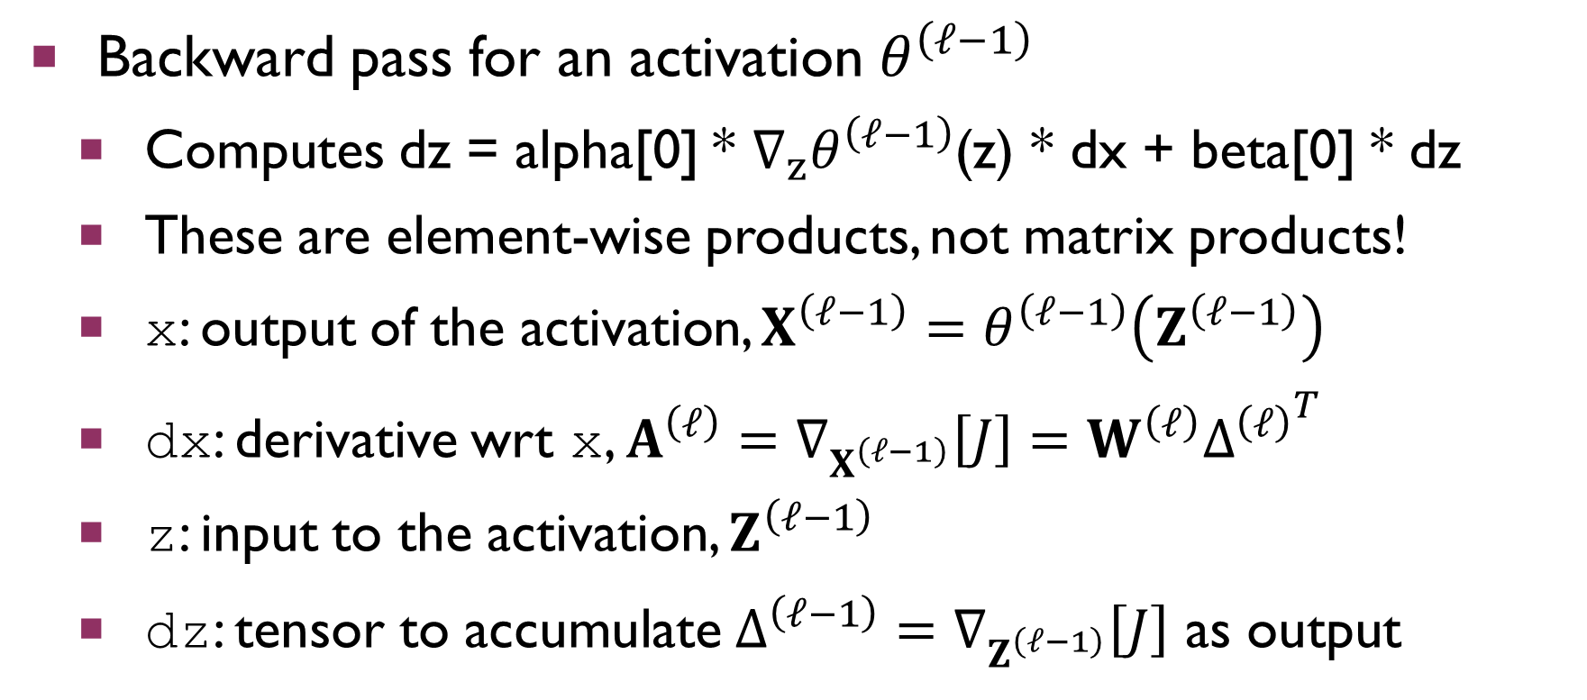
Activation Functions
Backward pass for an activation $θ^{\left(ℓ−1\right)}$
Computes dz = alpha[0] * $∇_{z}θ^{\left(ℓ−1\right)}$(z) * dx + beta[0] * dz
These are element-wise products, not matrix products!
x: output of the activation, $X^{\left(ℓ−1\right)}=θ^{\left(ℓ−1\right)}\left(Z^{\left(ℓ−1\right)}\right)$
dx: derivative wrt x, $A^{\left(ℓ\right)}=∇_{X^{\left(ℓ−1\right)}}\left[J\right]=W^{\left(ℓ\right)}{Δ^{\left(ℓ\right)}}^{T}$
z: input to the activation, $Z^{\left(ℓ−1\right)}$
dz: tensor to accumulate $Δ^{\left(ℓ−1\right)}=∇_{Z^{\left(ℓ−1\right)}}\left[J\right]$ as output

Slide 27
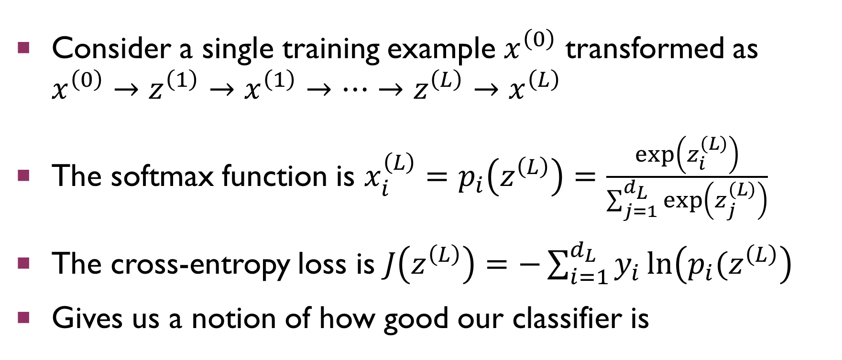
Softmax/Cross-Entropy Loss
Consider a single training example $x^{\left(0\right)}$ transformed as $x^{\left(0\right)}→z^{\left(1\right)}→x^{\left(1\right)}→…→z^{\left(L\right)}→x^{\left(L\right)}$
The softmax function is $x_{i}^{\left(L\right)}=p_{i}\left(z^{\left(L\right)}\right)=\frac{exp\left(z_{i}^{\left(L\right)}\right)}{\sum_{j=1}^{d_{L}}{\exp\left(z_{j}^{\left(L\right)}\right)}}$
The cross-entropy loss is $J\left(z^{\left(L\right)}\right)=−\sum_{i=1}^{d_{L}}{y_{i}\ln\left(p_{i}(z^{\left(L\right)}\right)}$
Gives us a notion of how good our classifier is

Slide 28
Softmax/Cross-Entropy Loss
Forward pass
Computes tensor x = alpha[0] * softmax(z) + beta[0] * x
cudnnSoftmaxForward(cudnnHandle_t handle, cudnnSoftmaxAlgorithm_t alg, cudnnSoftmaxMode_t mode, void *alpha, cudnnTensorDescriptor_t zDesc, void *z, void *beta, cudnnTensorDescriptor_t xDesc, void *x)

Slide 29
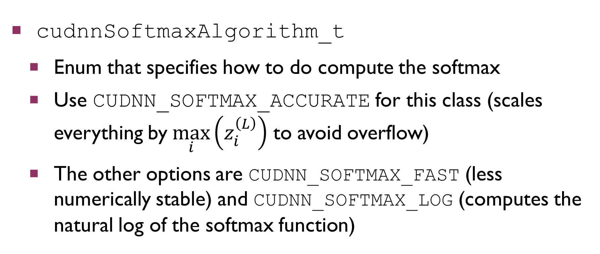
Softmax/Cross-Entropy Loss
cudnnSoftmaxAlgorithm_t
Enum that specifies how to do compute the softmax
Use CUDNN_SOFTMAX_ACCURATE for this class (scales everything by$\max_{i}\left(z_{i}^{\left(L\right)}\right)$ to avoid overflow)
The other options are CUDNN_SOFTMAX_FAST (less numerically stable) and CUDNN_SOFTMAX_LOG (computes the natural log of the softmax function)

Slide 30
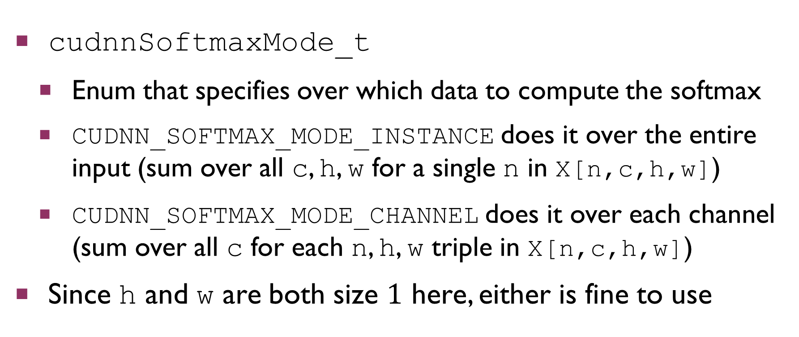
Softmax/Cross-Entropy Loss
cudnnSoftmaxMode_t
Enum that specifies over which data to compute the softmax
CUDNN_SOFTMAX_MODE_INSTANCE does it over the entire input (sum over all c, h, w for a single n in X[n,c,h,w])
CUDNN_SOFTMAX_MODE_CHANNEL does it over each channel (sum over all c for each n, h, w triple in X[n,c,h,w])
Since h and w are both size $1$ here, either is fine to use

Slide 31
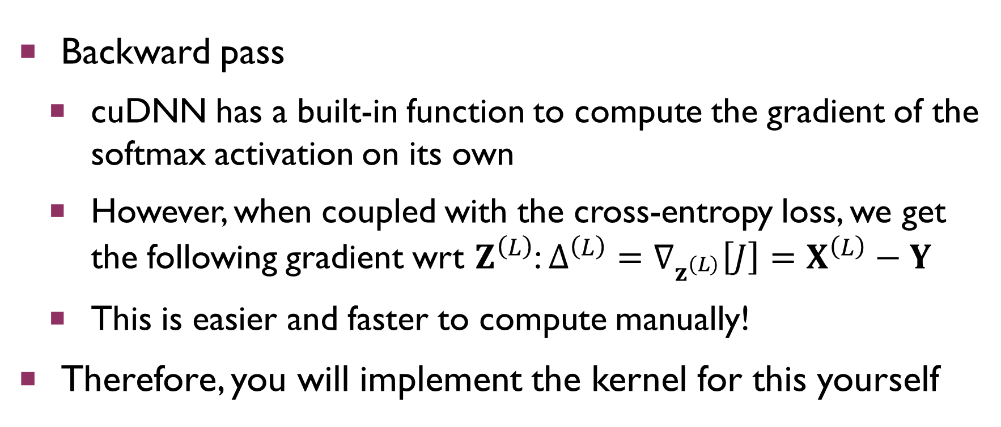
Softmax/Cross-Entropy Loss
Backward pass
cuDNN has a built-in function to compute the gradient of the softmax activation on its own
However, when coupled with the cross-entropy loss, we get the following gradient wrt $Z^{\left(L\right)}$: $Δ^{\left(L\right)}=∇_{z^{\left(L\right)}}\left[J\right]=X^{\left(L\right)}−Y$
This is easier and faster to compute manually!
Therefore, you will implement the kernel for this yourself

Slide 32
Softmax with Other Losses
Backward pass
For different losses, use the following function:
cudnnSoftmaxBackward(cudnnHandle_t handle, cudnnSoftmaxAlgorithm_t alg, cudnnSoftmaxMode_t mode, void *alpha, cudnnTensorDescriptor_t xDesc, void *x, cudnnTensorDescriptor_t dxDesc, void *dx, void *beta, cudnnTensorDescriptor_t dzDesc, void *dz)

Slide 33
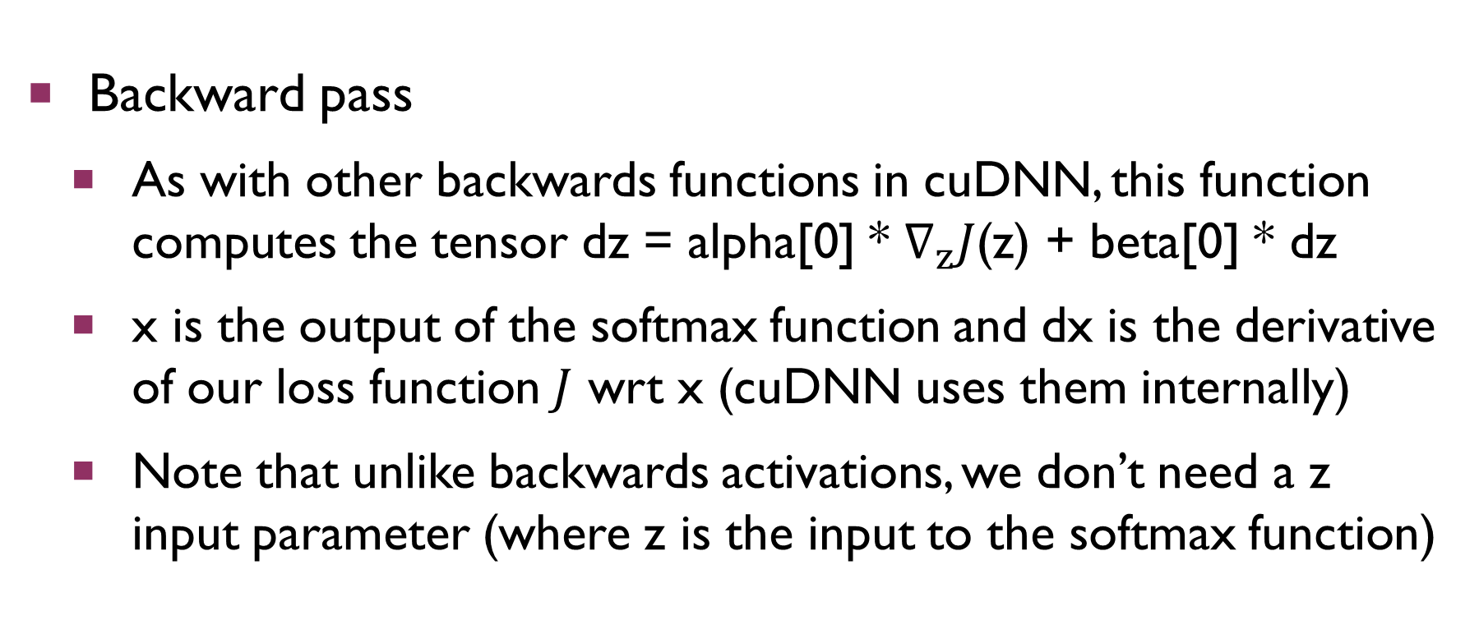
Softmax With Other Losses
Backward pass
As with other backwards functions in cuDNN, this function computes the tensor dz = alpha[0] * $∇_{z}J$(z) + beta[0] * dz
x is the output of the softmax function and dx is the derivative of our loss function $J$ wrt x (cuDNN uses them internally)
Note that unlike backwards activations, we don’t need a z input parameter (where z is the input to the softmax function)

Slide 34
Summary
Defining data in terms of tensors
Using those tensors as arguments to cuDNN’s built-in functions for both the forwards and backwards passes through a neural network
You can find more details about everything we discussed in NVIDIA’s official cuDNN developer guide
Next week: convolutional neural nets

